Slide 1
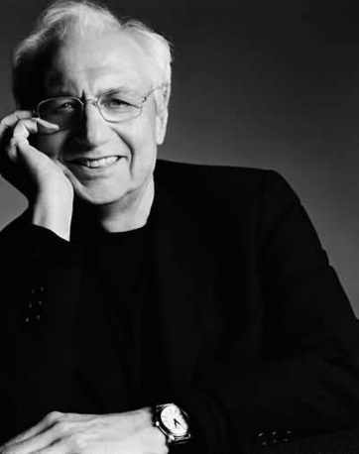
THE ARCHITECT :
FRANK GEHRY

Slide 2
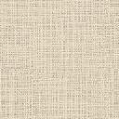
28th FEBRUARY 1929
Born in Toronto, Ontario, with the name Frank Owen Goldberg. Frank was creative at a young age, building imaginary homes from items found in his grandfather’s hardware store.
1947
Moves with his family to Los Angeles, California
SEPTEMBER 1951-MAY 1954
Received degree in architecture at School of Architecture, University of Southern California, Los Angeles. Attends second year of graduate school in architecture. He held a variety of jobs while attending college.
SEPTEMBER 1956- FEBRUARY 1957
Gehry moved to Massachusetts with his wife to enroll at the Harvard Graduate School of Design.

Slide 3
1970’s
Gehry launched “Easy Edges” a cardboard furniture line and remodeled his home for his family in Santa Monica with the money earned. He began designing homes on regular basis.
2000’s
As Gehry achieved celebrity status, he built high concept buildings including Walt Disney Concert Hall in Los Angeles, The Dancing House in Prague and The Guggenheim Museum building in Bilbao , Spain
LATER LIFE
In recent years, Gehry has served as a professor of architecture in Columbia University, Yale and University of Southern California.

Slide 4
INTRODUCTION ON THE DESIGN

Slide 5
DESIGN APPROACH
Gehry is known for his choice of unusual materials. His selection materials such as corrugated metal lends some of Gehry’s designs an unfinished or even crude aesthetic.
ARTISTIC MOVEMENT
The architectural style at that point of the era was post-modern architecture. Gehry boldly executed the Deconstructivist style.
INSPIRATIONS AND INFLUENCES
Unconventional building materials found in his grandfather’s hardware store. Made a collage of “junk” materials called “Cheapskate Architecture” in college.Had also sold furniture crafted from layers of corrugated cardboard.

Slide 6
INTRODUCTION ON THE BUILDING:
GEHRY’S RESIDENCE

Slide 7
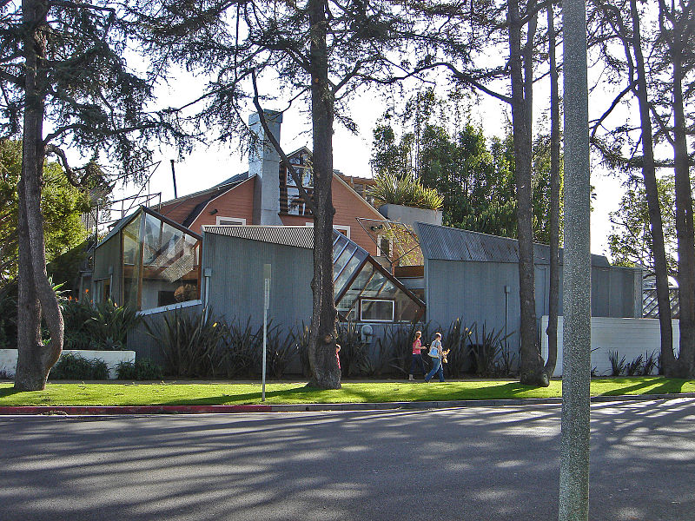
In 1977, Frank and Breta Gehry bought a pink Dutch Colonial, two storey, gambrel-roofed bungalow on a corner lot set in Santa Monica

Slide 8
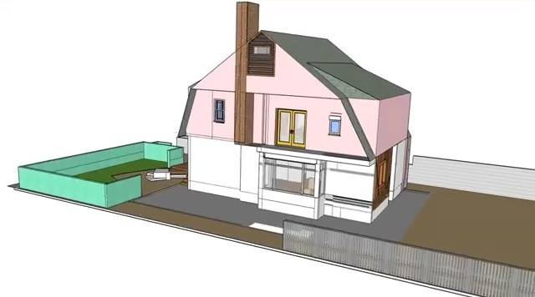
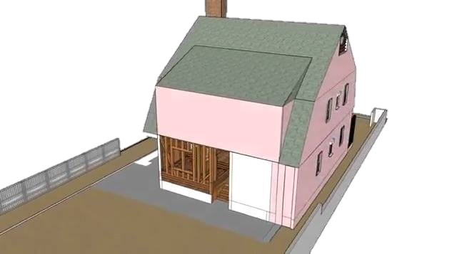
ORIGINAL BUILDING

Slide 9
REMODELING
1. Kept the existing house , but not in
it’s conventional manner.
2. Re-designed the house as a
work of deconstructionest
architecture.
3. Gehry’s additional design
wrapped the house from three
sides leaving the rear façade
untouched.

Slide 10
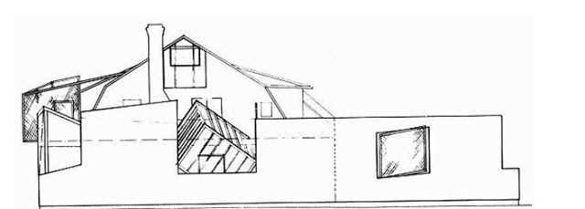
NORTH ELEVATION
Corrugated sheet metal wraps the most public facades to the north and east. A tilted glass cube wedged between the new exterior and the old, positioned above the north - facing kitchen.

Slide 11
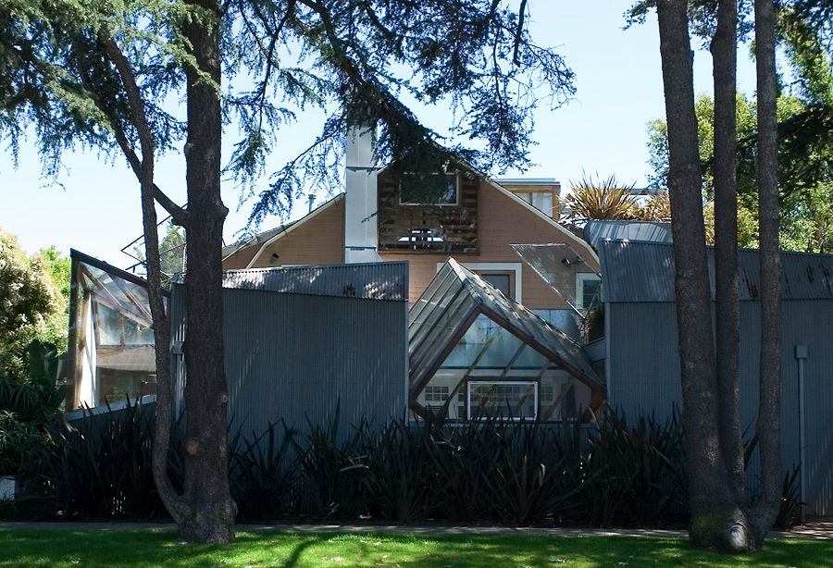
NORTH ELEVATION

Slide 12
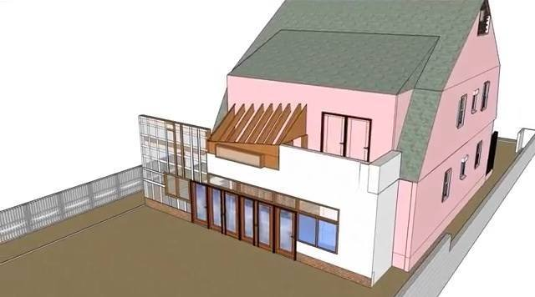
BACKYARD AREA
A second distorted cube forms a window for the dining room in the northeast corner. Along the north edge, the corrugated wall extends to enclose the backyard, making it a private courtyard

Slide 13
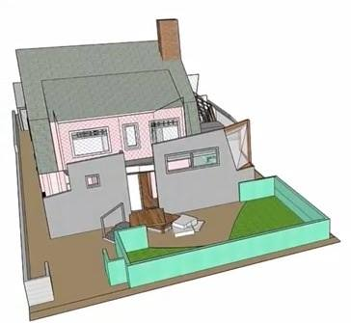
FRONT SIDE AREA
A terraced garden leads to the front door, chain link screens above revealing the rooflines of the old house. Inside walls and ceilings were stripped down to the wood lath and left exposed.

Slide 14
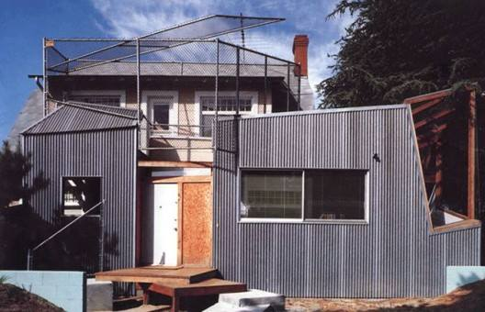
FRONT SIDE AREA

Slide 15
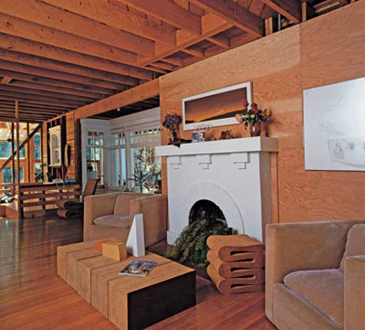
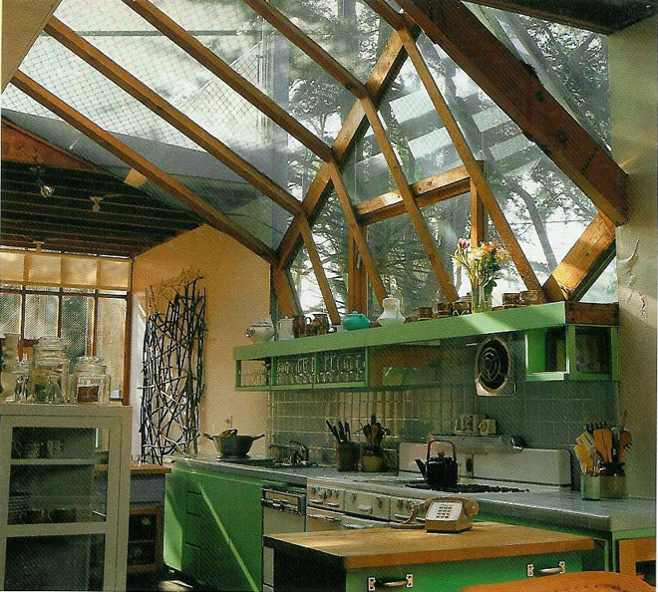
INTERIOR OF THE BUILDING
Living area
Kitchen

Slide 16
SITE CONTEXT

Slide 17
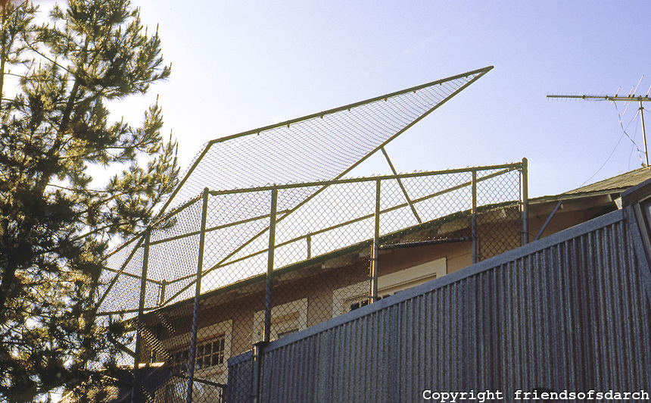
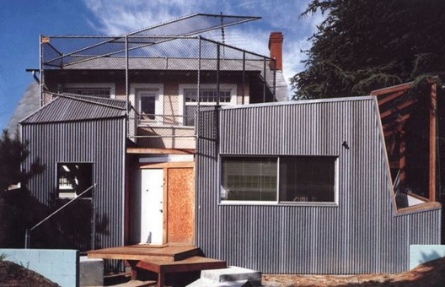
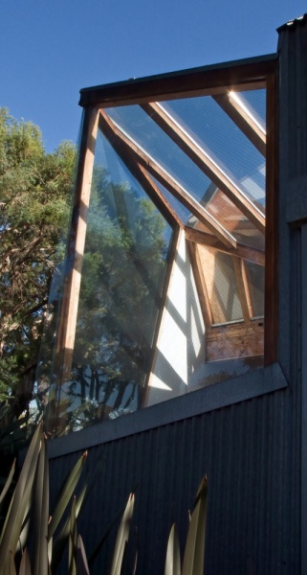
MATERIALS
Expressive possibilities of raw wood – frame construction.
Unconventional materials

Slide 18
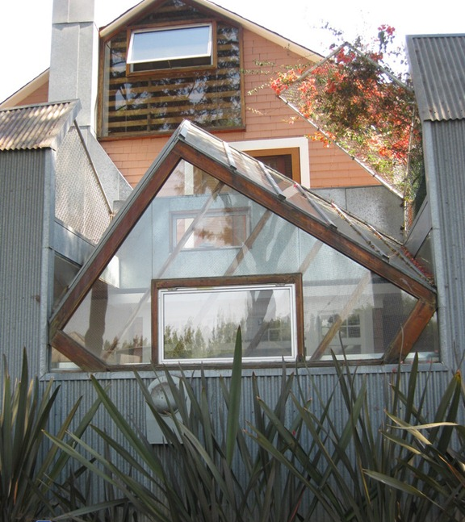
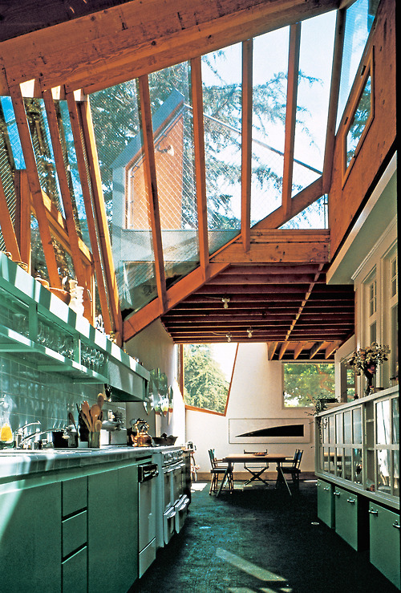
The sculpted shape and semi –
industrial raw materials
Asphalt floor
Corrugated layers of metal boxes Cubist skylights and windows was used to create a larger sense of space and movement in the kitchen and dining room.

Slide 19
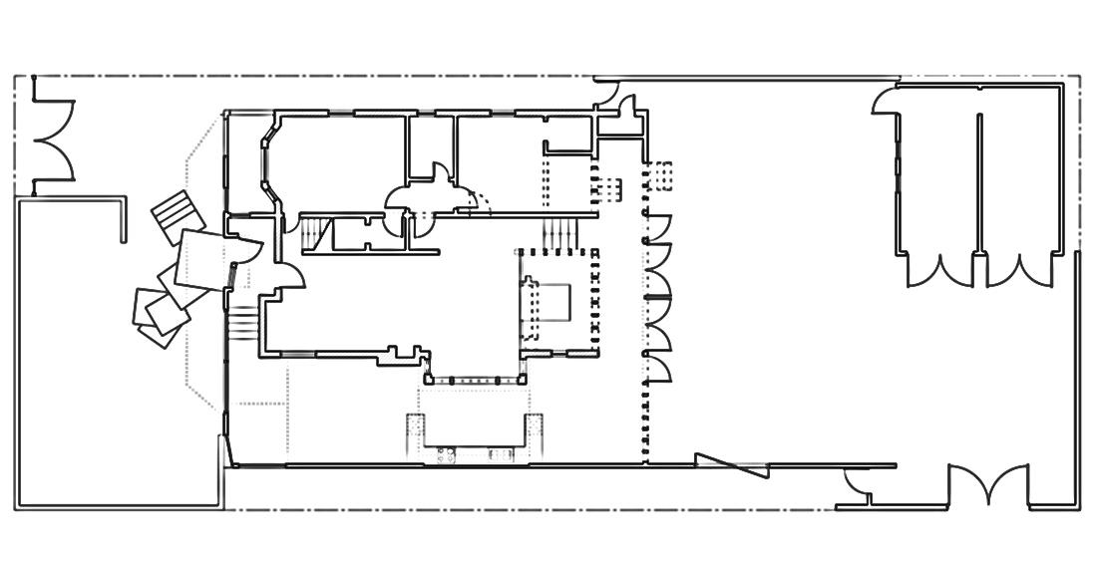
BEDROOM
BEDROOM
GARAGE
LIVING AREA
DINING ROOM
KITCHEN
GROUND FLOOR PLAN

Slide 20
BEDROOM
BEDROOM
GARAGE
LIVING AREA
DINING ROOM
KITCHEN
CIRCULATION AT THE GROUND FLOOR
Indicator:
Horizontal circulation
Vertical circulation

Slide 21
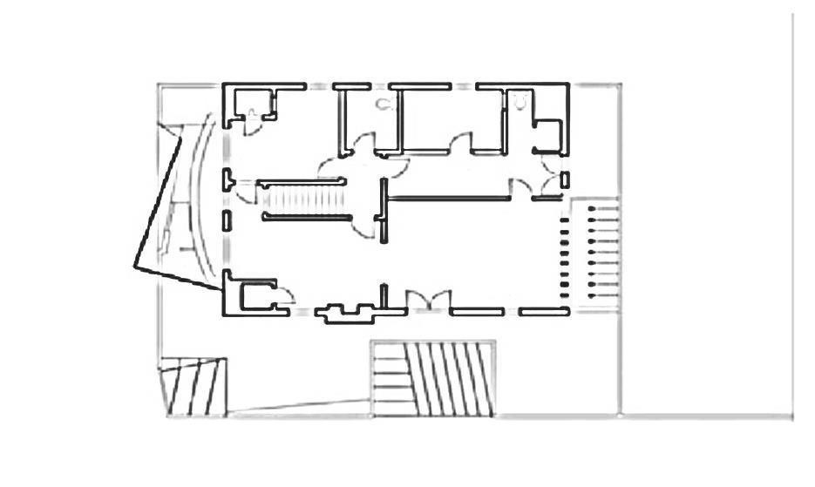
CLOSET
BEDROOM
MASTER BEDROOM
OUTDOOR DECK
FIRST FLOOR PLAN

Slide 22
CLOSET
BEDROOM
MASTER BEDROOM
OUTDOOR DECK
CIRCULATION AT THE FIRST FLOOR

Slide 23
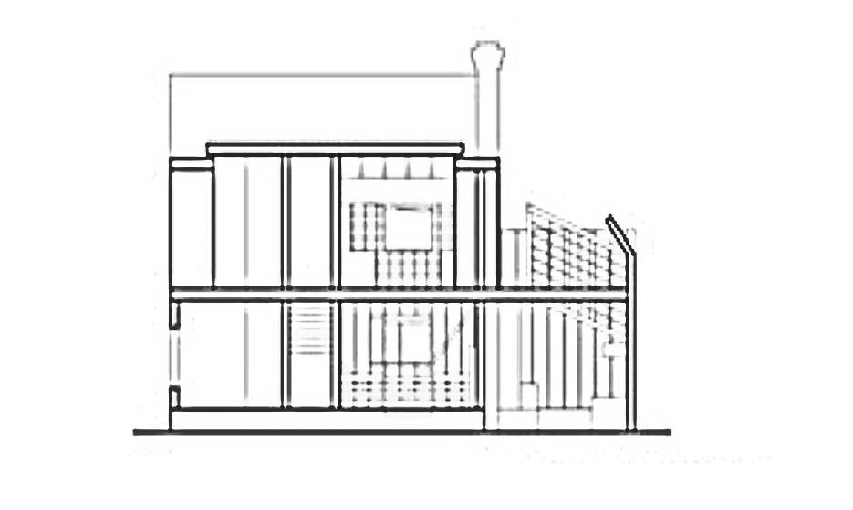
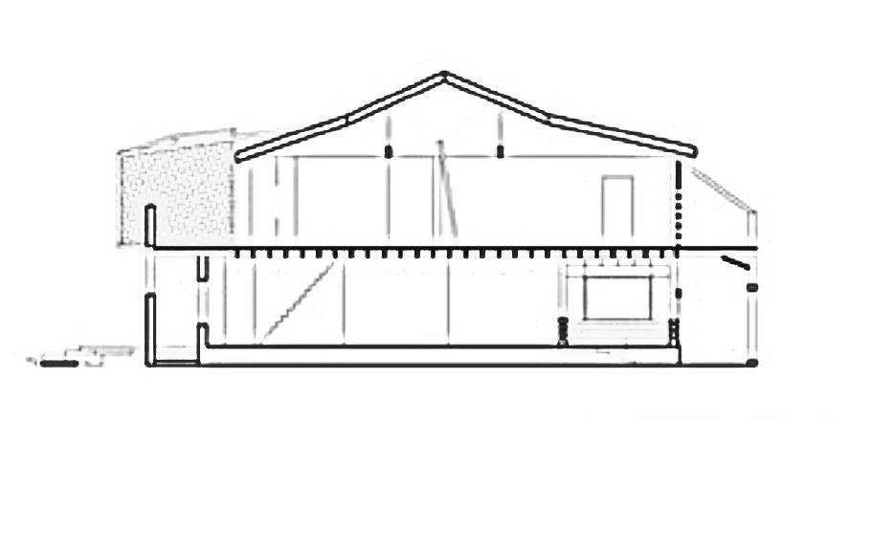
SECTION DRAWINGS OF THE BUILDING
SECTION A
SECTION B

Slide 24
THANK YOU

